Slide 1
Welcome to our presentation
Presented by Group 6:
Raisul Islam - 2111176139
Most Rima Khatun – 2112376130
Tasnim Tahmina Jarin – 2212076115
Tabassum Nishat Aitee - 2212076113

Slide 2
What is bus?
The Bus Matrix is an internal interconnection system that connects multiple bus masters (CPU, DMA) to multiple bus slaves (Flash, SRAM, peripherals) and manages data transfer between them efficiently.

Slide 3
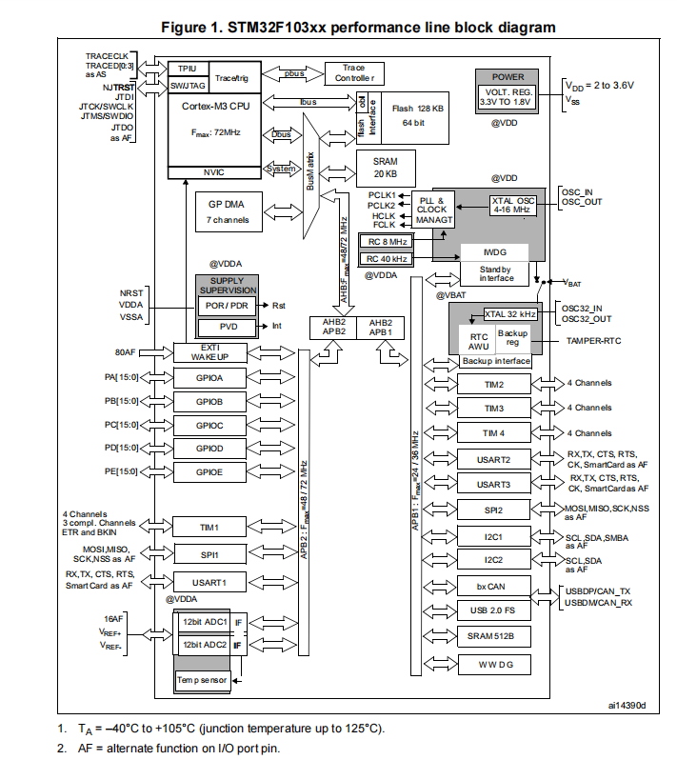
Bus matrix in STM32F103XX
There are seven types of bus:
P-Bus (Private bus)
I-Bus (Instruction bus)
D-Bus (Data bus)
System Bus
AHB (Advanced High-Performance Bus)
APB1 (Advanced Peripheral Bus 1)
APB2 (Advanced Peripheral Bus 2)

Slide 4
P-Bus (Private Peripheral Bus / PPB)
Purpose
To access core internal peripherals.
Where It Connects
Inside Cortex-M3 only
Debug Control Registers
Does not go to AHB or APB
Working Procedure
When CPU needs to handle an interrupt, access NVIC register, use trace or debug, the communication happens internally through P-bus.
It stays:
CPU P-Bus Core peripherals

Slide 5
I-Bus (Instruction Bus)
Purpose
To fetch program instructions from memory.
Where It Connects
Cortex-M3 CPU (Instruction Fetch Unit)
Flash Memory
Working Procedure
CPU needs next instruction.
Instruction address is sent via I-Bus.
Bus Matrix forwards request to Flash.
Flash sends instruction back.
CPU executes it.

Slide 6
D-Bus (Data Bus)
Purpose
To transfer data between CPU and memory/peripherals.
Where It Connects
Cortex-M3 CPU
Bus Matrix
SRAM, Flash
Peripherals (through AHB → APB bridge)
Working Procedure
CPU performs read/write operation.
Data address sent via D-Bus.
Bus Matrix routes to correct slave: SRAM, Flash, APB bridge
Data is transferred.

Slide 7
System Bus (S-Bus)
Purpose
When the CPU wants to access system components like GPIO, ADC, USART, Timers, RCC etc.
Where It Connects
Cortex-M3
Bus Matrix
AHB
Working Procedure
CPU executes an instruction to access a peripheral.
CPU sends the address and control signal through the System Bus.
The request goes to the Bus Matrix.
Bus Matrix forwards it to AHB.
AHB sends it to APB1 or APB2 through a bridge.
The peripheral performs the read/write operation.

Slide 8
AHB (Advanced High-Performance Bus)
Purpose
Main high-speed backbone bus of STM32.
AHB is the main high-speed highway that transfers data between CPU, memory, DMA and APB bridges inside the STM32F103xx.
Where It Connects
Bus Matrix
Flash
SRAM
DMA
AHB → APB1 bridge
AHB → APB2 bridge
Working Procedure
CPU or DMA sends a request to the Bus Matrix.
Bus Matrix forwards it to AHB.
AHB transfers data at high speed (up to 72 MHz).
AHB sends the data to:
Flash/SRAM Or to APB1/APB2 through bridges.

Slide 9
APB1 (Advanced Peripheral Bus 1)
Purpose
To connect low-speed peripherals.
APB1 handles low-speed peripherals by receiving requests from AHB and forwarding them to communication and timer modules.
Where It Connects
Through AHB → APB1 Bridge Connected to:
TIM2, TIM3, TIM4
USART2, USART3
SPI2
I2C1, I2C2
CAN
USB
WWDG
Working Procedure
CPU sends request through System bus.
Bus matrix → AHB.
AHB → APB1 bridge converts protocol.
Address delivers data to low speed peripheral.
Peripheral register accessed.
Data returned to CPU.

Slide 10
APB2 (Advanced Peripheral Bus 2)
Purpose
To connect high-speed peripherals.
APB2 manages high-speed peripherals and operates at higher frequency for faster response.
.Where It Connects
Through AHB → APB2 Bridge Connected to:
GPIOA–E
TIM1
USART1
SPI1
ADC1, ADC2
Working Procedure
CPU sends request through System bus.
Bus matrix → AHB.
AHB → APB2 bridge converts protocol.
Address delivers data to high speed peripheral.
Peripheral register accessed.
Data returned to CPU.

Slide 11

THANK YOU

